Slide 1
Day 1
Introduction to UNIX in RNA-seq Data Analysis
Zahra Tavakol
October 2025

Slide 2
Notes:
The McGill initiative on Computational Medicine was formed in 2017 and aims to deliver inter-disciplinary research programs and empower the use of data in health research and health care delivery
Located at the Genome Center
They have a newsletter were you can subscribe to
more info on the web site

Slide 3
Outline
Module 2 — UNIX Basics
File management and navigation
File inspection
Pipes and redirects
Text search
https://github.com/QLS-MiCM/Intro-to-UNIX/tree/main
R Troubleshooting (if time)
Setup & Troubleshooting
UNIX availability check
Fix PATH / permissions
Module 1 — GEO Basics
Accession types
Common files
FTP/HTTPS & Data Download

Slide 4
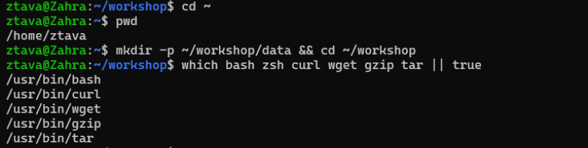
Setup & Troubleshooting
pwd
mkdir -p ~/workshop/data && cd ~/workshop
which bash zsh curl wget gzip tar || true

Slide 5
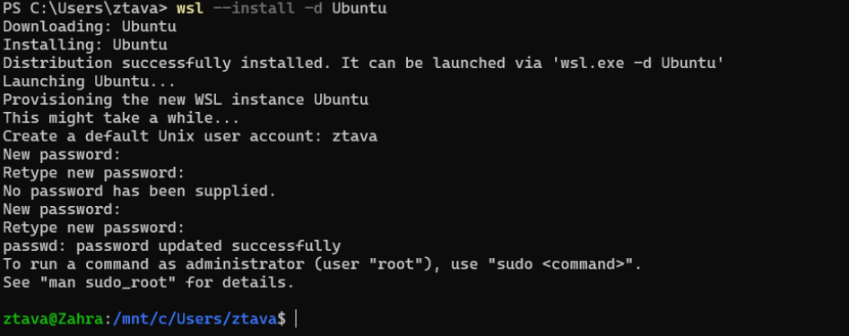
wsl --install -d Ubuntu
wsl -l -v
wsl -d Ubuntu
exit or Ctrl+D → To exit
wsl --unregister "Ubuntu"
sudo apt update -y
sudo apt install -y curl wget gzip tar grep gawk sed

Slide 6
Module 1
GEO Basics

Slide 7
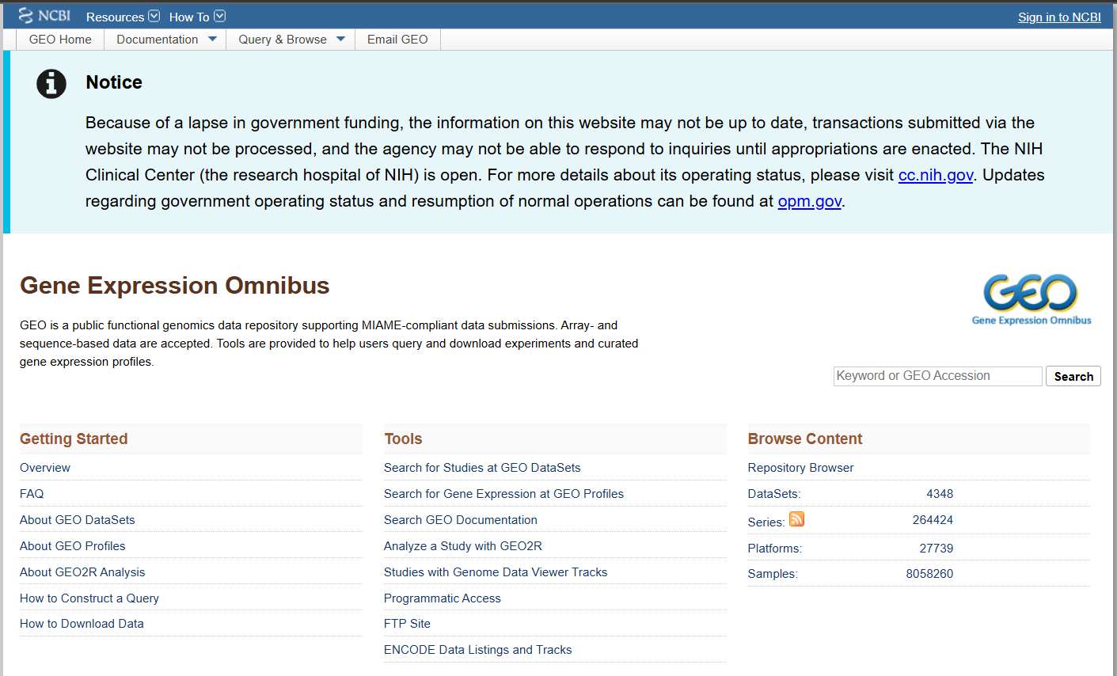
GEO (Gene Expression Omnibus)

Slide 8
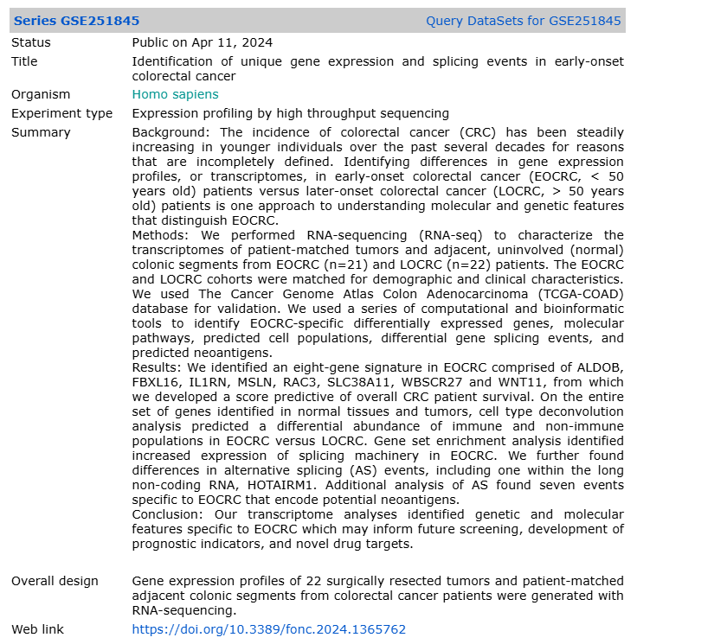
GSE251845

Slide 9
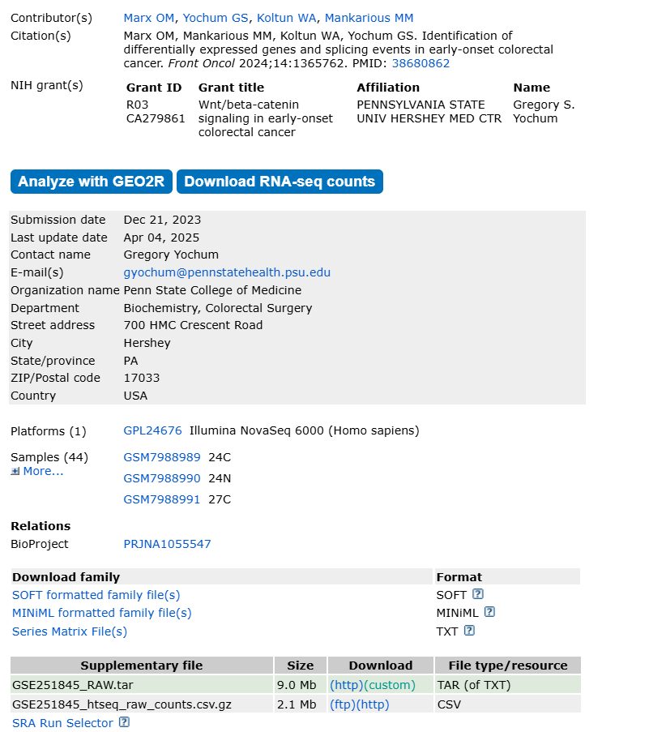
GEO accessions: GSE (series), GSM (samples), GPL (platform)
Processed data: Series Matrix / SOFT / tabular files
Raw count data: in supplementary file
Raw reads: usually in SRA/ENA as SRR… → *.fastq.gz
Raw (FASTQ): larger; needed for alignment/QC

Slide 10
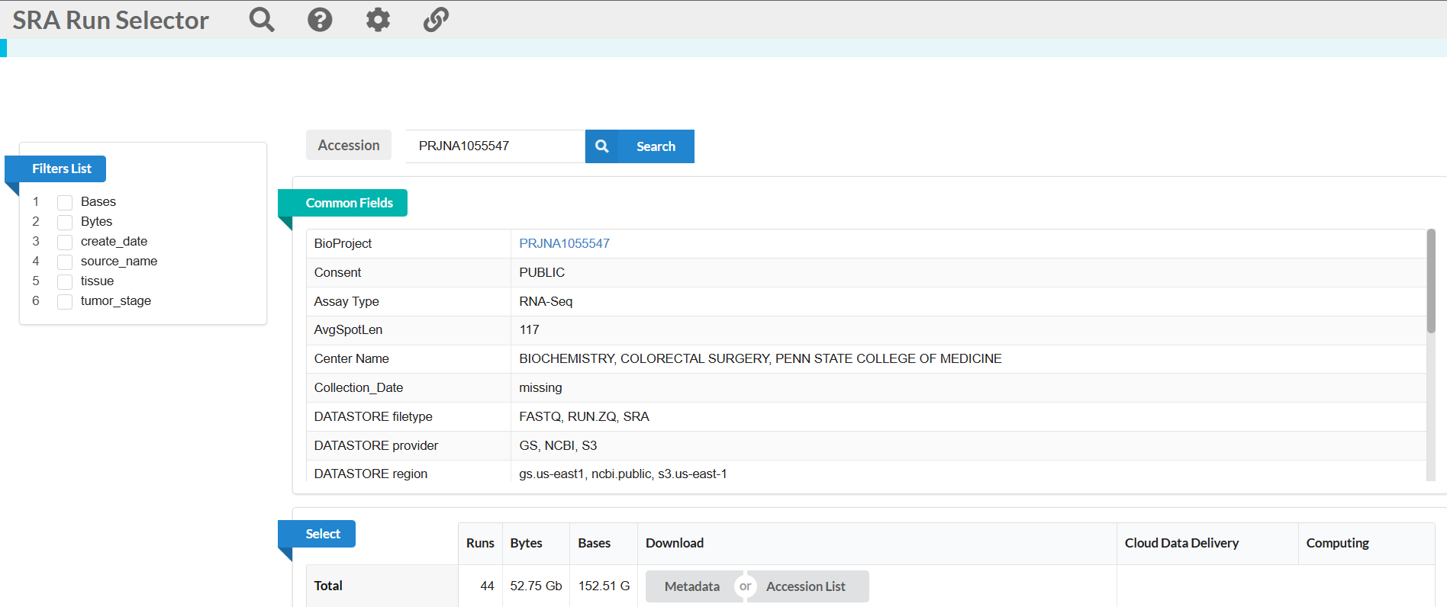
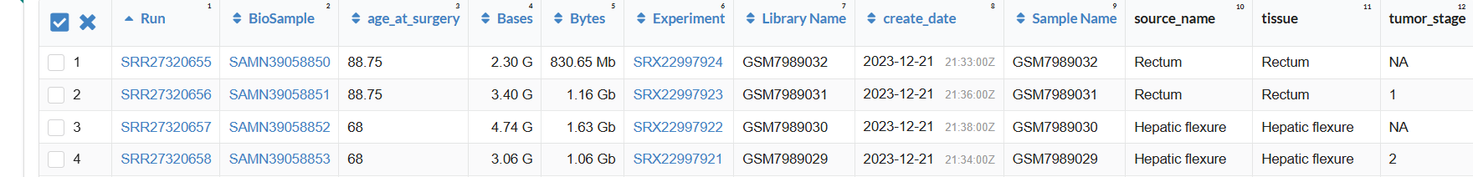
Notes:
To get fastq/fasta data

Slide 11
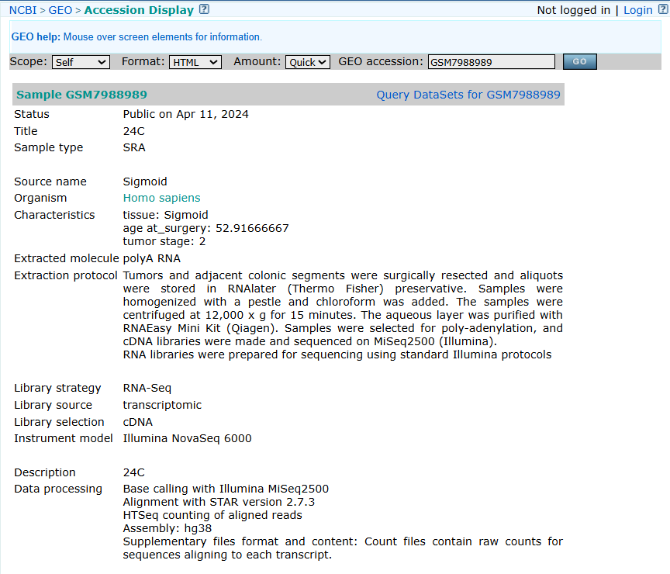

Slide 12
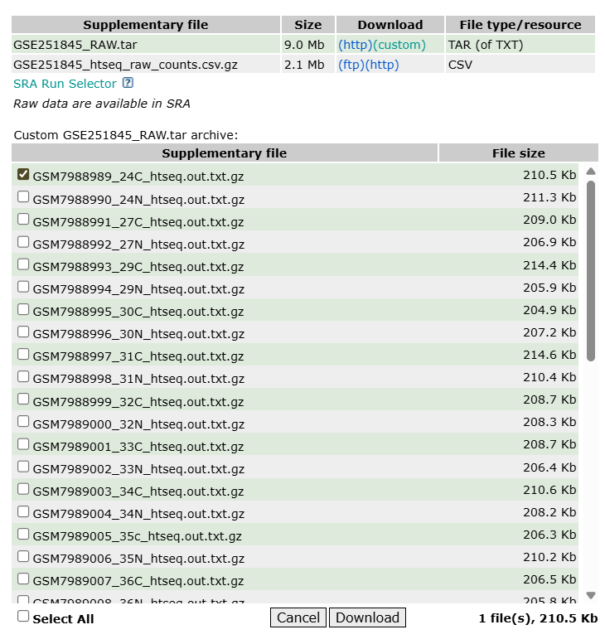

Slide 13
Exercise 1.1
Pick any GSE you like (or use the example on the slide). Using your browser only, download one of:
Processed matrix — the Series Matrix (or SOFT) from the GSE page.
Counts table (if provided) — a Supplementary file named like *_counts.txt, htseq_counts, or featureCounts (tab/CSV).
Raw reads (one run) — a single small SRR FASTQ (from SRA Run Selector or the ENA “Run” page).

Slide 14
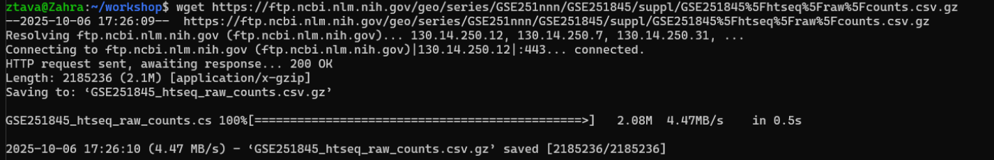
FTP / HTTPS Download
Pick one tool: curl -L -O <URL> or wget <URL>

Slide 15
Exercise 1.2
Recreate your manual download using a command:
In your data folder: cd ~/workshop/data
Run one: curl -C - -L -O "<URL-from-Exercise-1.1>"
wget -c "<URL-from-Exercise-1.1>"
Verify: ls -lh

Slide 16
Module 2
UNIX Basics
https://github.com/QLS-MiCM/Intro-to-UNIX/tree/main

Slide 17
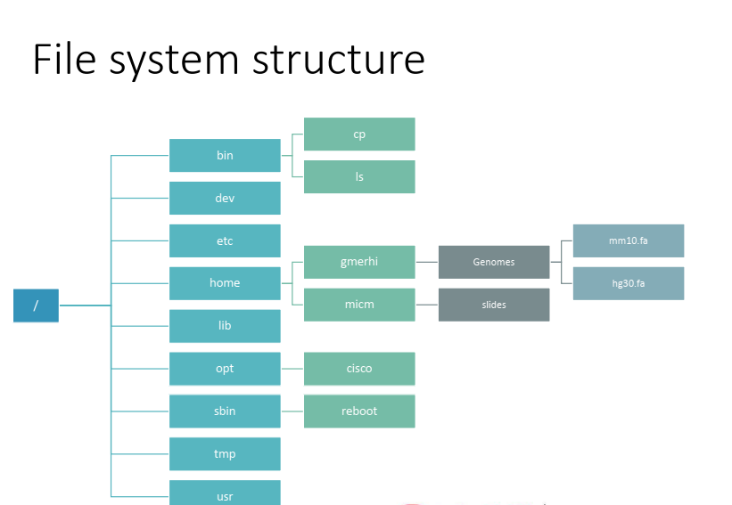

Slide 18
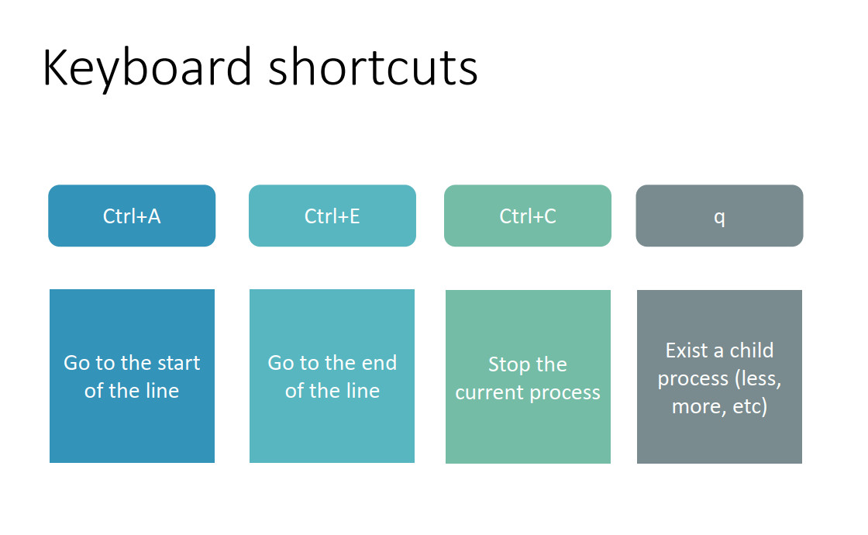

Slide 19
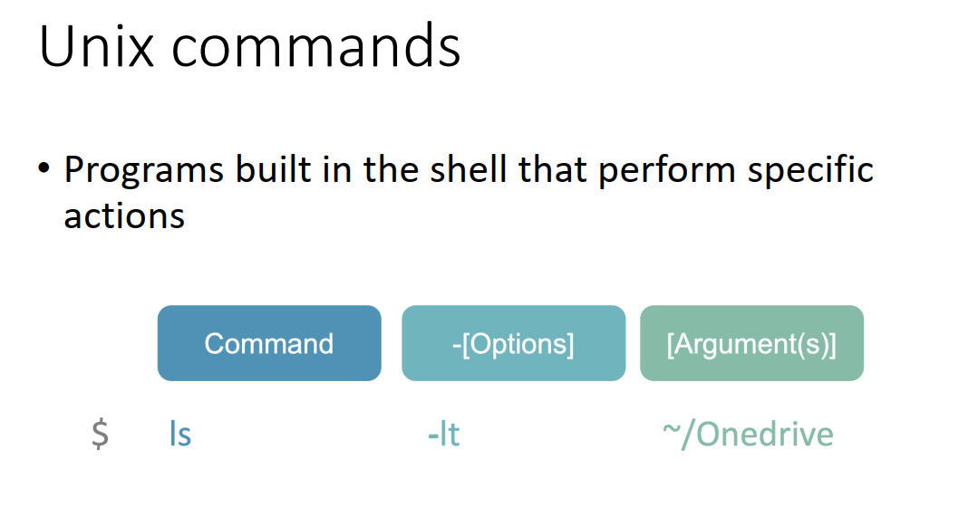

Slide 20
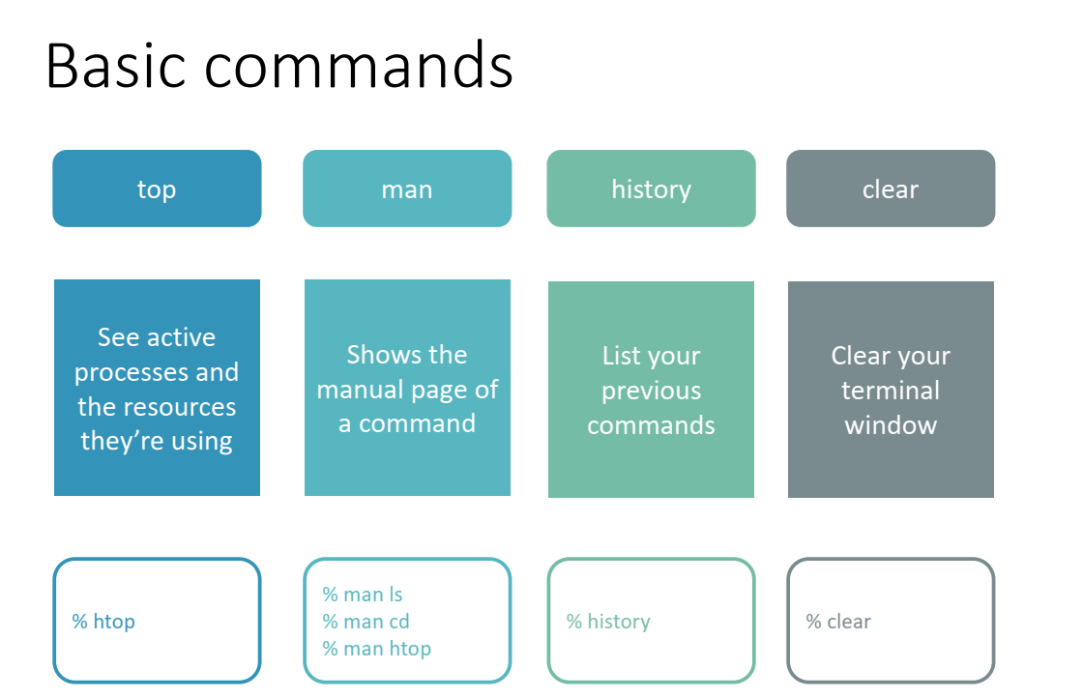

Slide 21
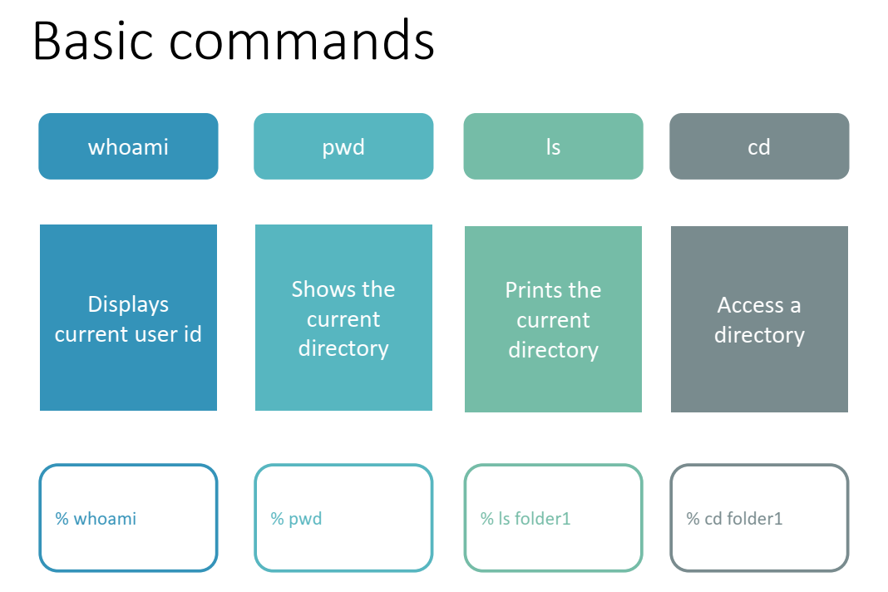

Slide 22
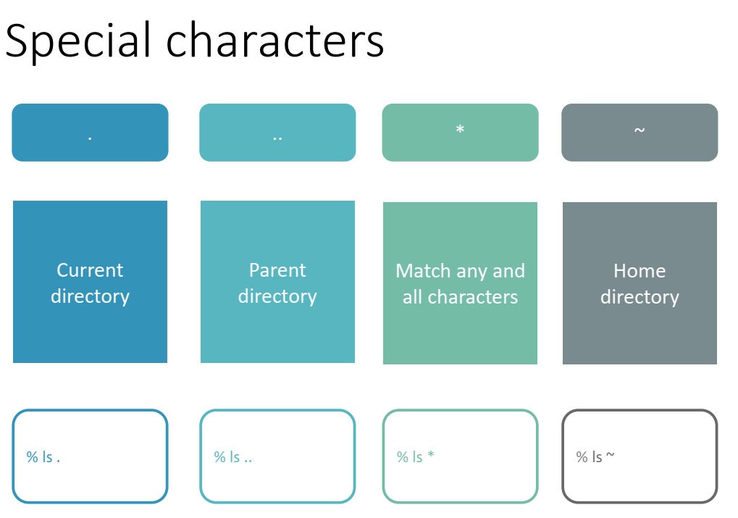

Slide 23
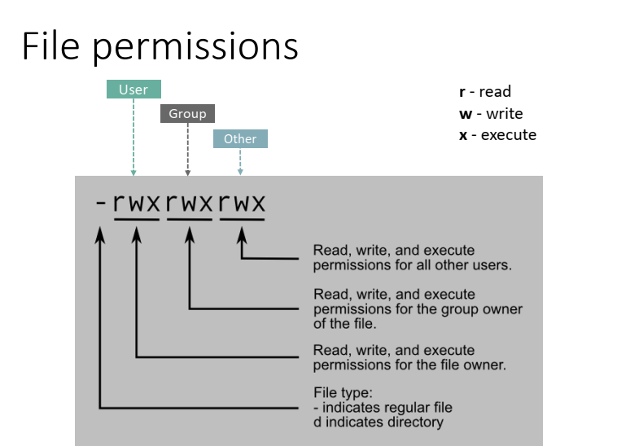

Slide 24
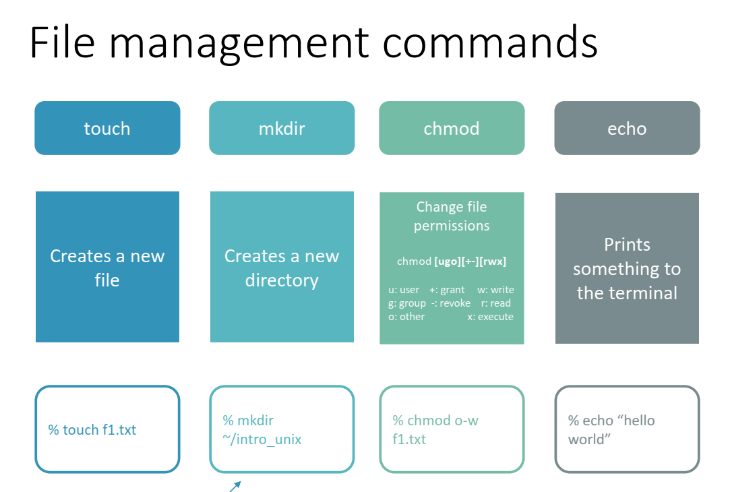

Slide 25
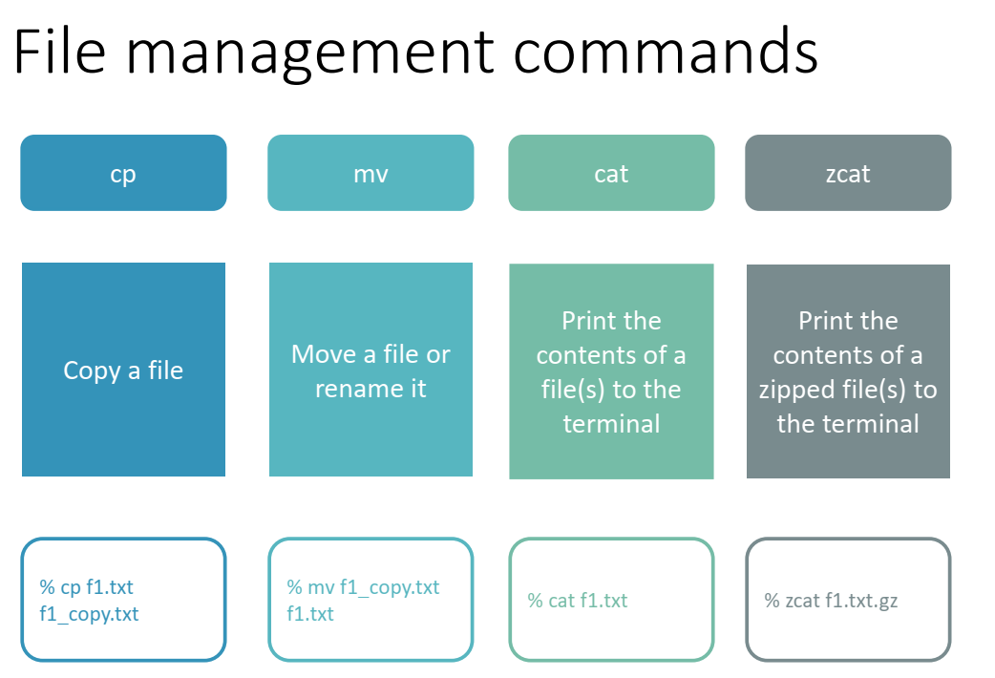

Slide 26
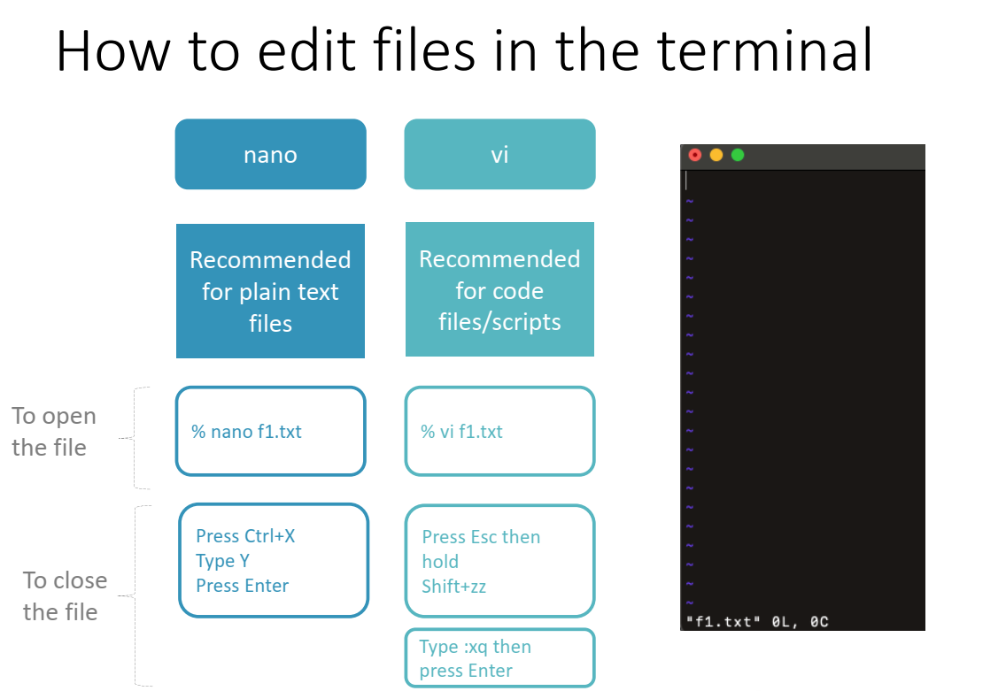

Slide 27
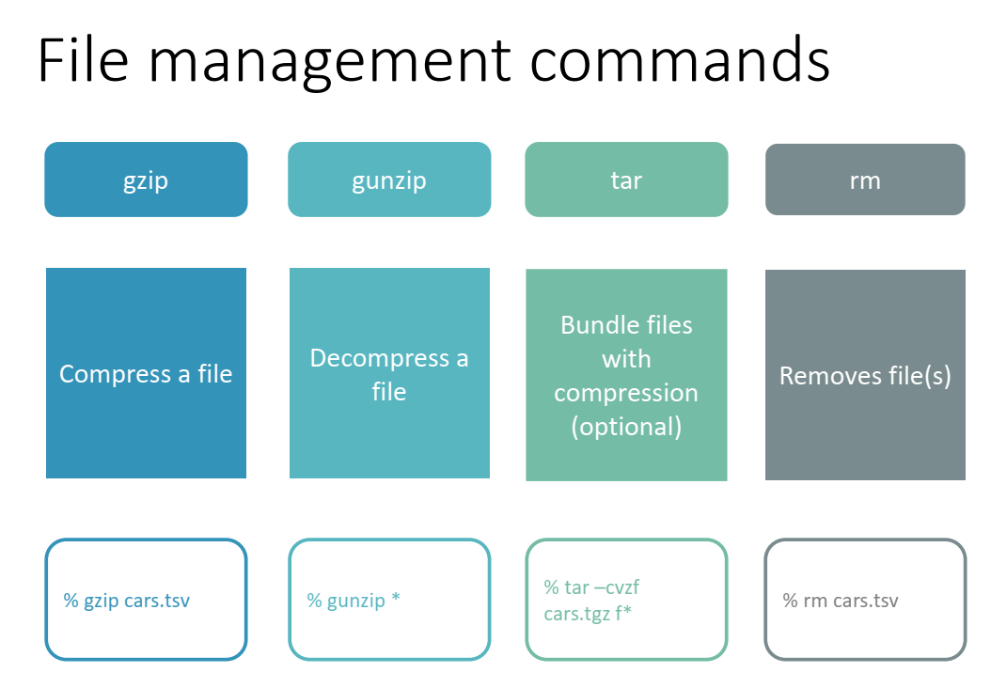

Slide 28
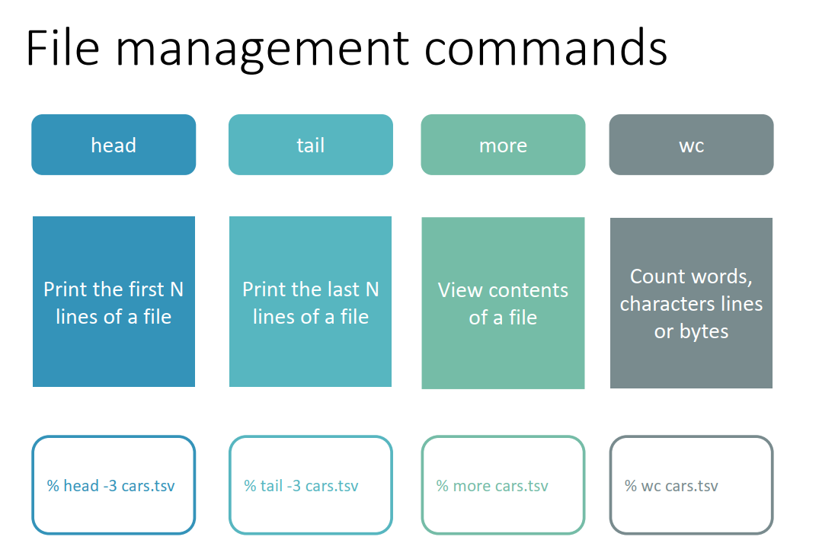

Slide 29
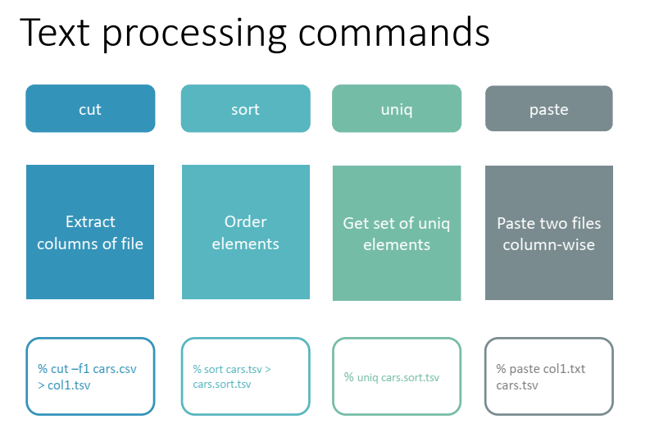

Slide 30
Exercise 2
1. Print the current directory and list all the contents of the directory
2. Create a directory named intro_unix in the home directory
3. Create a directory called data within intro_unix and sub-directories ho1 ho2 and ho3
4. Create a directory called folder1 under data/ho1
5. Go into folder1 and create two files: f1.txt and .f2.txt
6. Write the numbers from 1 to 10 in f1.txt (one number per line)
7. Change the name of .f2.txt to f2.txt
8. Write only the first 10 lines of f1.txt and all the lines in f2.txt to a new file called f3.txt

Slide 31
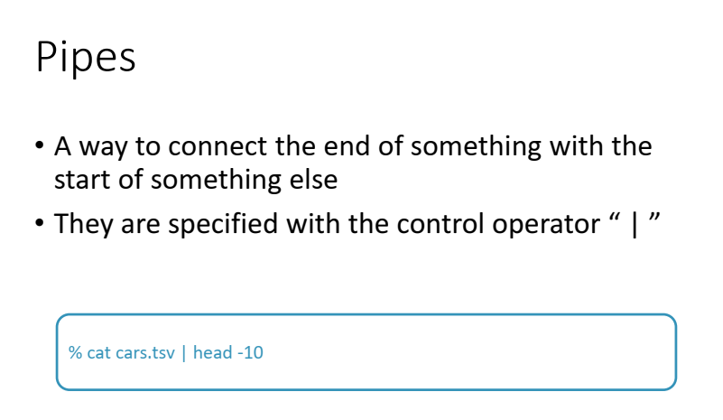

Slide 32
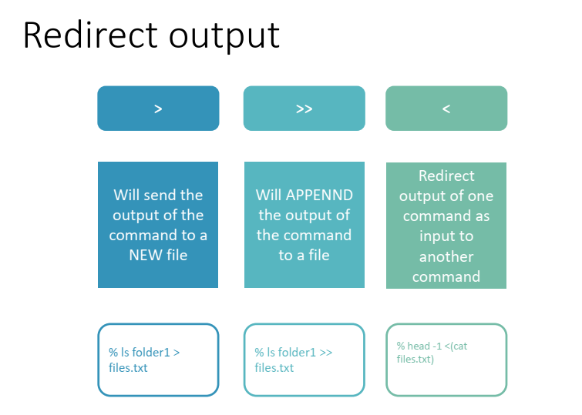

Slide 33
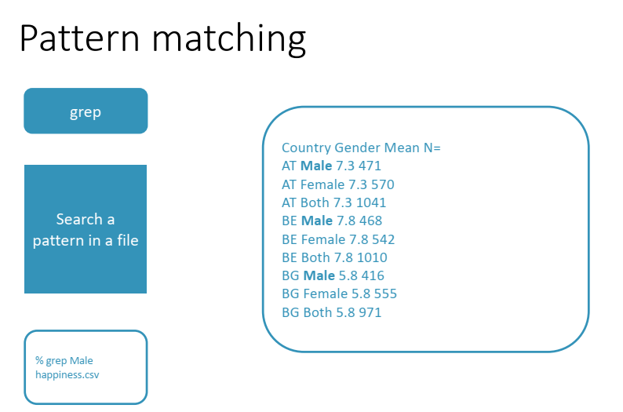

Slide 34
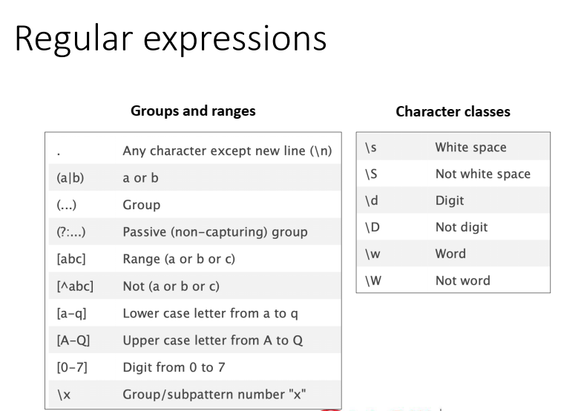

Slide 35
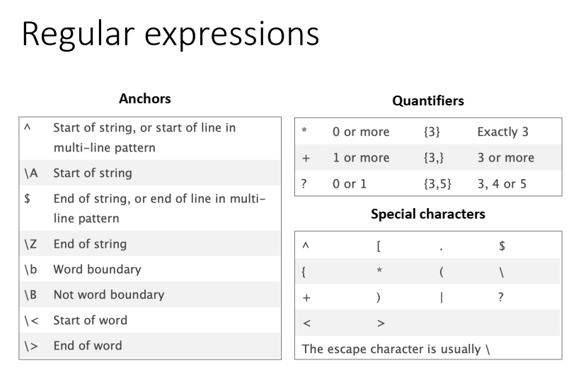

Slide 36
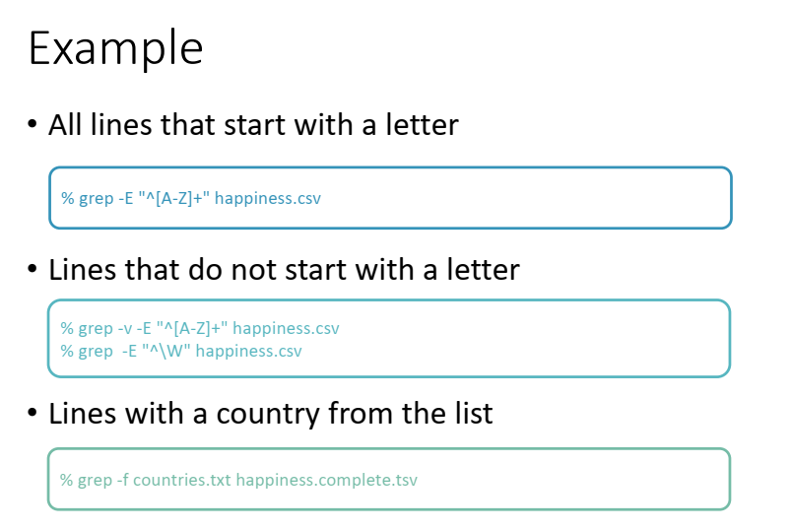

Slide 37
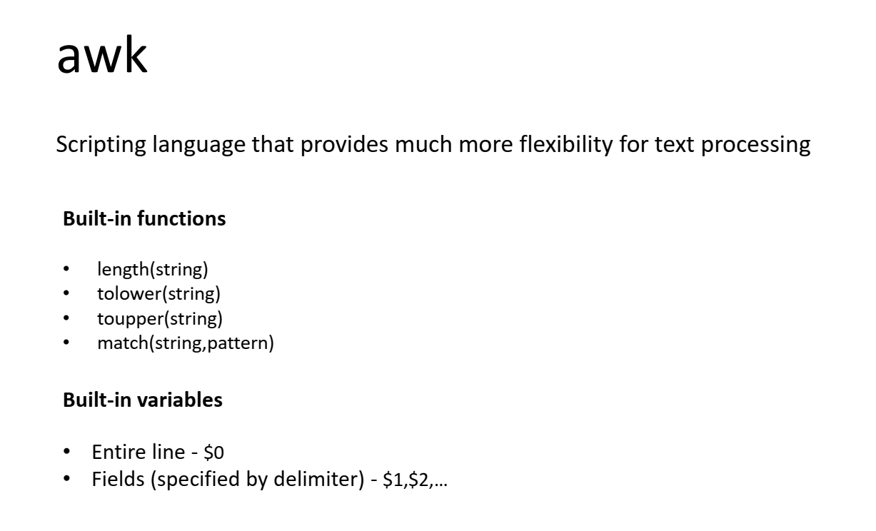

Slide 38
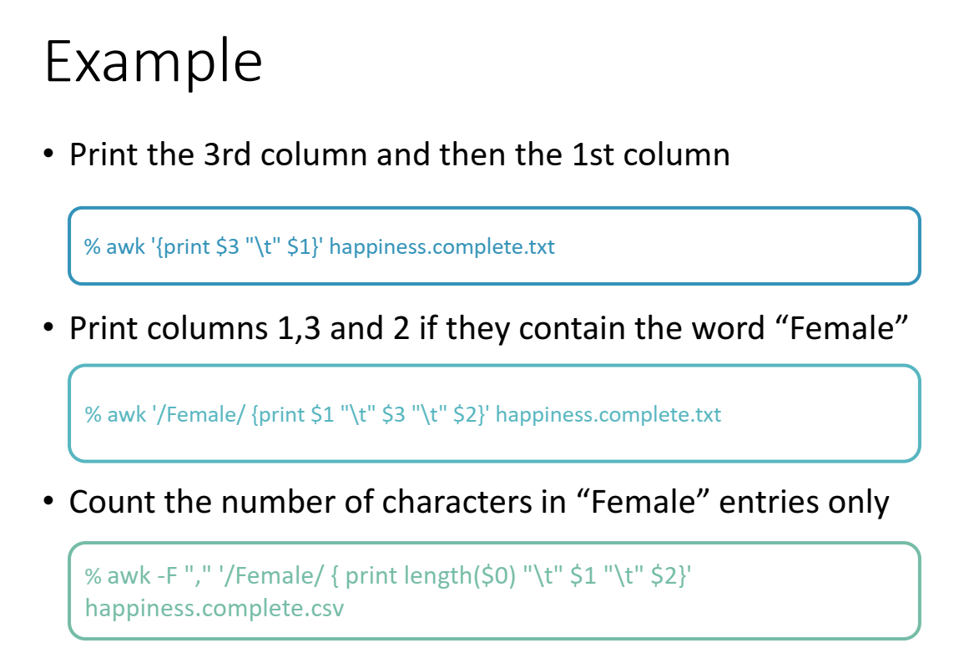

Slide 39
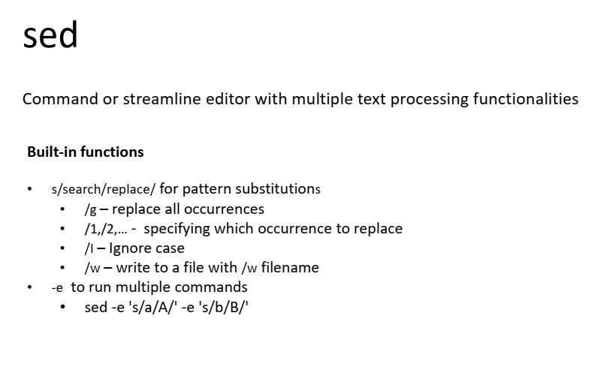

Slide 40
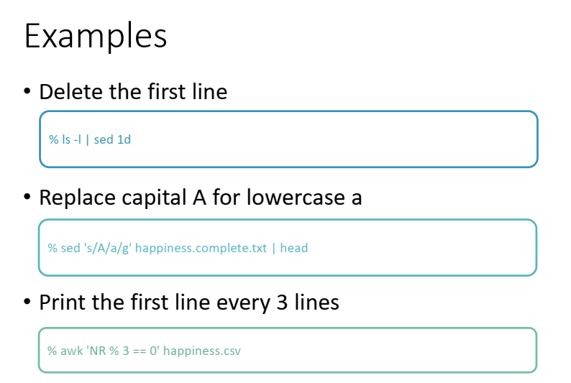

Slide 41
Exercise 3.1
1. Preview & row count (zcat/ gunzip)
Show the first 10 and last 5 lines.
Report the number of data rows (exclude header).
2. Print the header with column indices so you can choose sample columns.
zcat GSE251845_htseq_raw_counts.csv.gz | head -n 1 | awk -F',' '{for(i=1;i<=NF;i++) printf("%d\t%s\n", i, $i)}'
3. Pick & extract
Choose two sample columns (your choice) plus the gene ID column.
Save to subset_cols.csv.
4. Sort (sort -t',' -k3,3nr)
Sort subset_cols.csv descending by one of your sample columns.
Keep the header; save as sorted_subset.csv.

Slide 42
Exercise 3.1
5. Low-information checks
ANY-zero genes: genes with at least one zero across samples.
awk -F',' 'NR>1 && ($2==0 || $3==0){c++} END{print c}' # ANY-zero
ALL-zero genes: genes with all zeros across samples.
Also report highly expressed genes for one chosen sample column (e.g., counts ≥ 1000).

Slide 43
Exercise 3.2
Move/copy your downloaded *.fastq files into your working directory.
Count reads (headers) — no decompression needed (hint: @)
Find how many reads contain ambiguous base ‘N’
Top 10 most common 6-mers at the 5' end
Motif search (choose a short motif, e.g., ACGTAC)
Take the first 100 reads

